Slide 1
Elasticity and Its Applications

Slide 2
Elasticity
The focus of this lecture is the elasticity. Students will learn about the price elasticity of demand, price elasticity of supply, cross elasticity, income elasticity and its application.
It allows us to analyze supply and demand with greater precision.
Example: Rice farmer, IIT Hyderabad researchers have devised a new hybrid of rice.
Elasticity is a measure of how much buyers and sellers respond to changes in market conditions

Slide 3
THE ELASTICITY OF DEMAND
Price elasticity of demand is a measure of how much the quantity demanded of a good responds to a change in the price of that good.
Price elasticity of demand is the percentage change in quantity demanded given a percent change in the price.

Slide 4
The Price Elasticity of Demand and Its Determinants
Demand tends to be more elastic :
the larger the number of close substitutes.
if the good is a luxury.
the more narrowly defined the market.
the longer the time period.

Slide 5
Determinants of Price Elasticity of Demand
Various factors influence the price elasticity of demand. Here are some of them:
1. Substitutes: If a product can be easily substituted, its demand is elastic, like Gap's jeans. If a product cannot be substituted easily, its demand is inelastic, like gasoline.
2. Luxury Vs Necessity: Necessity's demand is usually inelastic because there are usually very few substitutes for necessities. Luxury product, such as leisure sail boats, are not needed in a daily bases. There are usually many substitutes for these products. So their demand is more elastic.
3. Price/Income Ratio: The larger the percentage of income spent on a good, the more elastic is its demand. A change in these products' price will be highly noticeable as they affect consumers' budget with a bigger magnitude. Consumers will respond by cutting back more on these product when price increases. On the other hand, the smaller the percentage of income spent on a good, the less elastic is its demand.
4. Time lag: The longer the time after the price change, the more elastic will be the demand. It is because consumers are given more time to carry out their actions. A 1-day sale usually generate less sales change per day as a sale lasted for 2 weeks.

Slide 6
Computing the Price Elasticity of Demand
The price elasticity of demand is computed as the percentage change in the quantity demanded divided by the percentage change in price.

Slide 7
Computing the Price Elasticity of Demand
Example: If the price of an ice cream cone increases from $2.00 to $2.20 and the amount you buy falls from 10 to 8 cones, then your elasticity of demand would be calculated as:

Slide 8
The Midpoint Method
A Better Way to Calculate Percentage Changes and Elasticities
The midpoint formula is preferable when calculating the price elasticity of demand because it gives the same answer regardless of the direction of the change.

Slide 9
Why midpoint method is better?
Point A: Price = 4, Quantity = 120
Pont B: Price = 6, Quantity = 80
E_{A} = 33/50 = 0.66 (Quantity fall & Price rise)
E_{B} = 50 /33 = 1.5 (Price fall & Quantity rise)
Different arises because of shift in base
To avoid this problem, one can use Midpoint method
Midpoint method gives the same answer regardless of direction of change.

Slide 10
The Midpoint Method…..
Example: If the price of an ice cream cone increases from 2.00 to 2.20 and the amount you buy falls from 10 to 8 cones, then your elasticity of demand, using the midpoint formula, would be calculated as:

Slide 11
The Variety of Demand Curves
Inelastic Demand
Quantity demanded does not respond strongly to price changes.
Price elasticity of demand is less than one.
Elastic Demand
Quantity demanded responds strongly to changes in price.
Price elasticity of demand is greater than one.

Slide 12
Computing the Price Elasticity of Demand
Price
$5
4
Demand
0
50
100
Quantity
Demand is price elastic

Slide 13
The Variety of Demand Curves
Perfectly Inelastic
Quantity demanded does not respond to price changes.
Perfectly Elastic
Quantity demanded changes infinitely with any change in price.
Unit Elastic
Quantity demanded changes by the same percentage as the price.

Slide 14
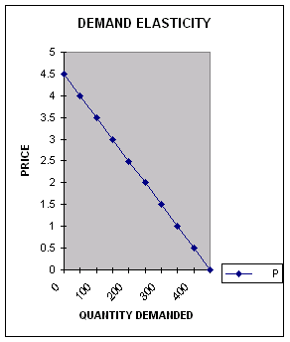
An Example
DEMAND FUNCTION FOR PRODUCT X: P = 2.5-0.01Q P = PRICE; Q = QUANTITY, TR = TOTAL REVENUE Ed = PRICE ELASTICITY OF DEMAND A B C D E F G H I J Q: 0 50 100 150 200 250 300 350 400 450 P: 4.5 4 3.5 3 2.5 2 1.5 1 0.5 0 Ed: 17 5 2.6 1.57 1 0.64 0.38 0.2 0.06 ELASTICITY OF DEMAND; FROM A TO E Ed >1 FROM E TO F Ed =1 FROM F TO J Ed <1

Slide 15

Figure 1 The Price Elasticity of Demand
(a) Perfectly Inelastic Demand: Elasticity Equals 0
Price
Demand
$5
4
1. An
increase
in price . . .
0
100
Quantity
2. . . . leaves the quantity demanded unchanged.
Copyright©2003 Southwestern/Thomson Learning

Slide 16
Figure 1 The Price Elasticity of Demand
(b) Inelastic Demand: Elasticity Is Less Than 1
Price
$5
4
1. A 22%
Demand
increase
in price . . .
0
90
100
Quantity
2. . . . leads to an 11% decrease in quantity demanded.

Slide 17
Figure 1 The Price Elasticity of Demand
(c) Unit Elastic Demand: Elasticity Equals 1
Price
$5
4
1. A 22%
Demand
increase
in price . . .
0
80
100
Quantity
2. . . . leads to a 22% decrease in quantity demanded.
Copyright©2003 Southwestern/Thomson Learning

Slide 18
Figure 1 The Price Elasticity of Demand
(d) Elastic Demand: Elasticity Is Greater Than 1
Price
$5
4
Demand
1. A 22%
increase
in price . . .
0
50
100
Quantity
2. . . . leads to a 67% decrease in quantity demanded.

Slide 19
Figure 1 The Price Elasticity of Demand
(e) Perfectly Elastic Demand: Elasticity Equals Infinity
Price
1. At any price
above $4, quantity
demanded is zero.
$4
Demand
2. At exactly $4,
consumers will
buy any quantity.
0
Quantity
3. At a price below $4,
quantity demanded is infinite.

Slide 20
Relation betweenTotal Revenue and the Price Elasticity of Demand
Total revenue is the amount paid by buyers and received by sellers of a good.
Computed as the price of the good times the quantity sold.
TR = P x Q

Slide 21
Figure 2 Total Revenue
Price
$4
P × Q = $400
P
(revenue)
Demand
0
100
Quantity
Q
Copyright©2003 Southwestern/Thomson Learning

Slide 22
Elasticity and Total Revenue along a Linear Demand Curve
With an inelastic demand curve, an increase in price leads to a decrease in quantity that is proportionately smaller. Thus, total revenue increases.

Slide 23
Figure 3 How Total Revenue Changes When Price Changes: Inelastic Demand
Price
Price
An Increase in price from $1
to $3 …
… leads to an Increase in total revenue from $100 to $240
$3
Revenue = $240
$1
Revenue = $100
Demand
Demand
0
100
Quantity
0
80
Quantity
Copyright©2003 Southwestern/Thomson Learning

Slide 24
With an elastic demand curve, an increase in the price leads to a decrease in quantity demanded that is proportionately larger. Thus, total revenue decreases.

Slide 25
Figure 4 How Total Revenue Changes When Price Changes: Elastic Demand
Price
Price
An Increase in price from $4
to $5 …
… leads to an decrease in total revenue from $200 to $100
$5
$4
Demand
Demand
Revenue = $200
Revenue = $100
0
50
Quantity
0
20
Quantity
Copyright©2003 Southwestern/Thomson Learning

Slide 26
TR Test Example
DEMAND FUNCTION FOR PRODUCT X: P = 2.5-0.01Q
P = PRICE; Q = QUANTITY, TR = TOTAL REVENUE
Ed = PRICE ELASTICITY OF DEMAND
A B C D E F G H I
Q: 0 50 100 150 200 250 300 350 400
P: 4.5 4 3.5 3 2.5 2 1.5 1 0.5
TR: 0 200 350 450 500 500 450 350 200
Ed: 17 5 2.6 1.57 1 0.64 0.38 0.2 0.06
ELASTICITY OF DEMAND;
FROM A TO E Ed >1 TR increases
FROM E TO F Ed =1 TR remains same.
FROM F TO I Ed <1 TR decreases.

Slide 27
Income Elasticity of Demand
Income elasticity of demand measures how much the quantity demanded of a good responds to a change in consumers’ income.
It is computed as the percentage change in the quantity demanded divided by the percentage change in income.

Slide 28
Computing Income Elasticity

Slide 29
Income Elasticity
Types of Goods
Normal Goods
Inferior Goods
Higher income raises the quantity demanded for normal goods but lowers the quantity demanded for inferior goods.

Slide 30
Income Elasticity
Goods consumers regard as necessities tend to be income inelastic
Examples include food, fuel, clothing, utilities, and medical services.
Goods consumers regard as luxuries tend to be income elastic.
Examples include sports cars, furs, and expensive foods.

Slide 31
THE ELASTICITY OF SUPPLY
Price elasticity of supply is a measure of how much the quantity supplied of a good responds to a change in the price of that good.
Price elasticity of supply is the percentage change in quantity supplied resulting from a percent change in price.

Slide 32
Figure 6 The Price Elasticity of Supply
(a) Perfectly Inelastic Supply: Elasticity Equals 0
Price
Supply
$5
4
1. An
increase
in price . . .
0
100
Quantity
2. . . . leaves the quantity supplied unchanged.
Copyright©2003 Southwestern/Thomson Learning

Slide 33
Figure 6 The Price Elasticity of Supply
(b) Inelastic Supply: Elasticity Is Less Than 1
Price
Supply
$5
4
1. A 22%
increase
in price . . .
0
100
110
Quantity
2. . . . leads to a 10% increase in quantity supplied.
Copyright©2003 Southwestern/Thomson Learning

Slide 34
Figure 6 The Price Elasticity of Supply
(c) Unit Elastic Supply: Elasticity Equals 1
Price
Supply
$5
4
1. A 22%
increase
in price . . .
0
100
125
Quantity
2. . . . leads to a 22% increase in quantity supplied.
Copyright©2003 Southwestern/Thomson Learning

Slide 35
Figure 6 The Price Elasticity of Supply
(d) Elastic Supply: Elasticity Is Greater Than 1
Price
Supply
$5
4
1. A 22%
increase
in price . . .
0
100
200
Quantity
2. . . . leads to a 67% increase in quantity supplied.
Copyright©2003 Southwestern/Thomson Learning

Slide 36
Figure 6 The Price Elasticity of Supply
(e) Perfectly Elastic Supply: Elasticity Equals Infinity
Price
1. At any price
above $4, quantity
supplied is infinite.
$4
Supply
2. At exactly $4,
producers will
supply any quantity.
0
Quantity
3. At a price below $4,
quantity supplied is zero.
Copyright©2003 Southwestern/Thomson Learning

Slide 37
APPLICATIONS OF SUPPLY, DEMAND, AND ELASTICITY
Can good news for farming be bad news for farmers?
What happens to wheat farmers and the market for wheat when university agronomists discover a new wheat hybrid that is more productive than existing varieties?

Slide 38
Figure 8 An Increase in Supply in the Market for Wheat
Price of
Wheat
1. When demand is inelastic,
2. . . . leads
an increase in supply
. . .
to a large fall
S₁
in price . . .
S₂
$3
2
Demand
0
100
110
Quantity of
Wheat
3. . . . and a proportionately smaller
increase in quantity sold. As a result,
revenue falls from $300 to $220.
Copyright©2003 Southwestern/Thomson Learning

Slide 39
Why did OPEC fail to keep the price of oil high?

Slide 40
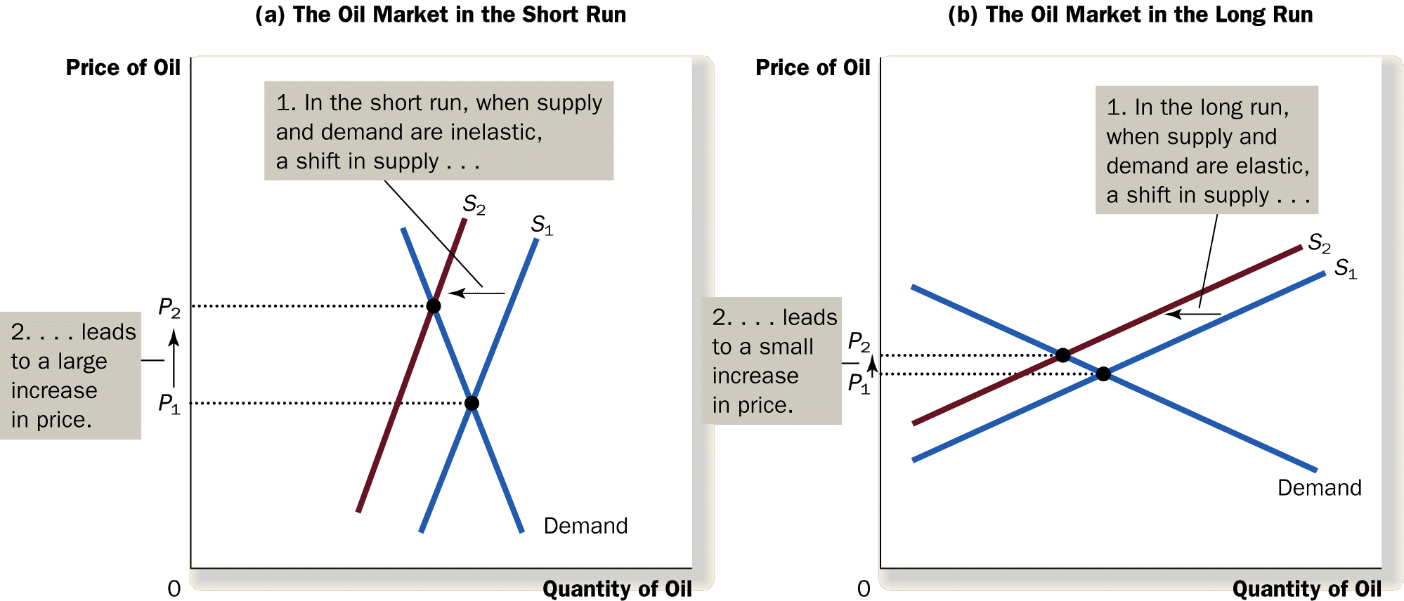
Figure 9a A Reduction in Supply in the World Market for Oil

Slide 41
Figure 9b A Reduction in Supply in the World Market for Oil

Slide 42
Does Drug Prohibition Increase or Decrease Drug-Related Crime?
Price of Drugs
Price of Drugs
Supply
S2
P2
S1
P1
P1
Demand
P2
D1
D2
0
Q2
Q1
Quantity of Drugs
0
Q2
Q1
Quantity of Drugs
(a) Drug Prohibition
(b) Drug Education

